Slide 1
Unit 5: Week 2
Grade K

Slide 2
Copyright © Savvas Learning Company LLC. All Rights Reserved.
This publication is protected by copyright, and permission should be obtained from the publisher prior to any prohibited reproduction, storage in a retrieval system, or transmission in any form or by any means, electronic, mechanical, photocopying, recording, or otherwise. For information regarding permissions, request forms, and the appropriate contacts within the Savvas Learning Company Rights Management group, please send your query to:
Savvas Learning Company LLC, 15 East Midland Avenue, Paramus, NJ 07652
or
k12learningpermissions@savvas.com
myView Literacy® is an exclusive trademark of Savvas Learning Company LLC in the U.S. and/or other countries.

Slide 3
Lesson 1

Slide 4
Phonological Awareness
honey
pepper
picture
machine
shampoo
handbag
Notes:
Tell students that today they are going to talk more about syllables. Listen carefully as I say this word: honey. How many syllables are in the word hon (clap) ey (clap)? Yes, there are two. What is the first syllable in honey? Students should say hon. What is the second syllable in honey? Students should say ey.
Listen carefully as I say this word: pepper. How many syllables are in pep (clap) per (clap)? Yes, there are two. What is the first syllable in pepper? Students should say pep. What is the second syllable in pepper? Students should say per.
Say the following words: picture, machine, shampoo, handbag. Then call on volunteers to clap, count, and identify the syllables in each word.

Slide 5
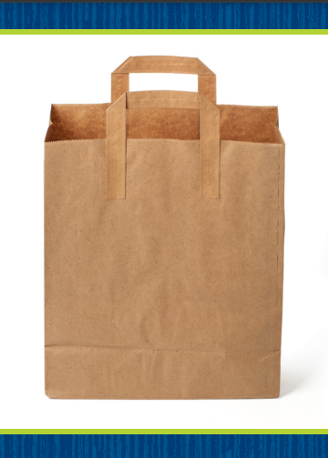
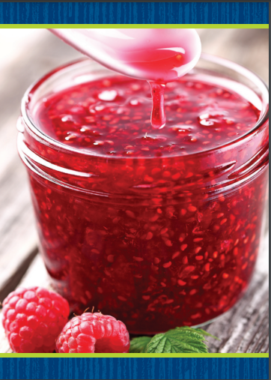
Page 52
Phonics
bone
bat
Bob
ban
jet
June
Jen
Jack
Notes:
Hold up the bag Picture Card. What sound do you hear at the beginning of bag? Have students identify /b/. The letter b spells the sound /b/ in bag. Turn the card over and read the word bag with students. Have students tell you the letters that are in the word bag. Click path -> Table of Contents -> Unit 5 Week 2 Informational Text -> Lesson 1
Now let’s practice reading more words with the sound /b/ spelled b. Write the words bone, bat, Bob, and ban on the board. These words have the sound /b/ spelled b. Read the words several times with students. Invite volunteers to circle the b in each word. Repeat the activity for the letters Jj. Use the jam Picture Card and the words jet, June, Jen, Jack, and job.
Have students turn to p. 52 in the Student Interactive. Read the first sentence with students. What does the first picture show? Students should say bat. What letter is missing from the word in the sentence? Students should say b. Have students write the word bat on the line. Then have them read the sentence again.

Slide 6
Page 52
Phonics
Turn to page 52 in your Student Interactive and complete the activity.
Notes:
Have students finish p. 52 in the Student Interactive.

Slide 7
High-Frequency Words
eat
soon
walk
Notes:
Display the high-frequency words eat, soon, and walk, and read them aloud.
Have students point to the word eat and read it.
Repeat for soon and walk.

Slide 8
Page 50, 51
Interact with Sources
Write one thing that helps a cactus live in the desert.
Notes:
Remind students of the Unit 5 Essential Question: What can we learn from the weather? Then draw their attention to the Weekly Question: What helps plants live in hot climates? Tell them that this week they will learn about how different plants deal with different kinds of weather, such as heat.
Have students follow along as you point to the pictures of the cactuses on pp. 50–51 of the Student Interactive. Explain that plants have developed ways to live in hot climates. Tell students that cacti have thick stems that hold water. Their roots also take in water quickly when it rains. Then read the infographic, “Living in the Desert.”
Use the following prompts to guide discussion:
Ask students to look at the background picture and tell what they see.
Have students describe what a desert is like.
Tell students to explain how plants can live in hot climates, such as a desert.
Encourage students to ask questions about the infographic to clarify anything they do not understand.
Have students interact with sources by using the pictures and text on pp. 50–51 to write one thing that helps a cactus live in the desert.
Point out the Week 2 Question: What helps plants live in hot climates? Tell students that they just learned about two ways that plants are able to live in hot climates. Desert plants have thick stems that hold water and roots that are able to take in water quickly when it rains. Explain that this week students will learn more about how plants live in hot climates.

Slide 9
Listening Comprehension
Life in the Rainforest
Rainforests are found near the equator, where it is hot.
2.
3.
4.
Notes:
Tell students that they will listen to an informational text. Informational text provides facts about things in our world. Have students listen as you read aloud the text, “Life in the Rainforest.” Encourage students to be active listeners by looking at you and thinking about what you are saying as you read aloud.
Have students listen actively for elements of informational text, such as factual information.
Read the entire text aloud without stopping for the Think Aloud callouts.
Reread the text aloud, pausing to model the Think Aloud strategies related to informational text.
Use the chart to help students identify factual information in the text.

Slide 10
Page 62, 63
Informational Text
Turn to page
62 in your Student Interactive.
Notes:
Tell students that informational text provides real facts and information. This information may include steps in a sequence. Knowing about informational text can help readers better understand it.
Informational text provides facts. Facts are information that is true.
Informational text may include steps in a sequence that tell the order in which something happens.
Understanding the steps in a sequence helps readers better understand the text. Writers include key words to help readers understand the order of the steps, such as first, next, and last.
Read the text and review the Anchor Chart on pp. 62–63 of the Student Interactive. Model an example of a sequence using the words first, next, and last.
Let’s talk about our morning. First, we put away our coats and backpacks. Next, we sit at our desks. Last, we take out our books.
Editable Anchor Chart Click Path: Table of Contents -> Reading Anchor Charts -> Unit 5 Week 2: Informational Text Editable Reading Anchor Chart

Slide 11
Page 62
Apply
Talk about the steps in order.
Notes:
Have students use the strategies for identifying sequence in an informational text.
Have students work with a partner to complete the Turn and Talk activity on p. 62 of the Student Interactive.
Then call on volunteers to share the steps with the class.

Slide 12
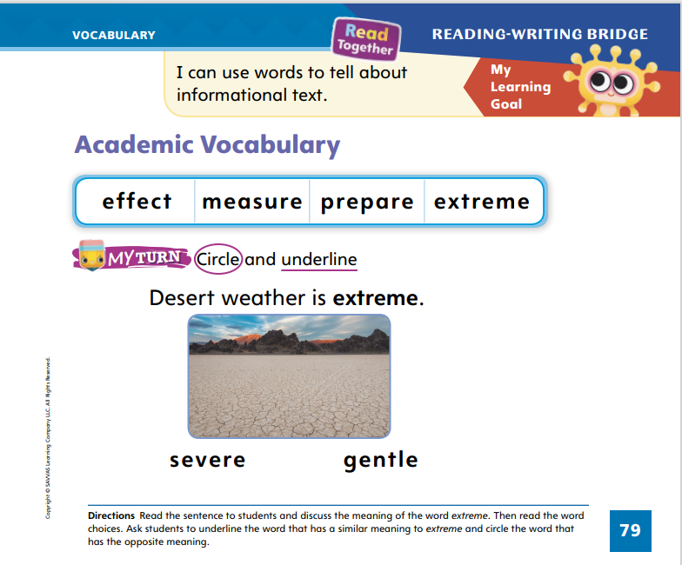
Page 79
Academic Vocabulary
severe
Turn to page 79 in your Student Interactive and complete the activity.
gentle
Notes:
Explain to students that synonyms are words with similar meanings and antonyms are words with opposite meanings. Have students turn to p. 79 in the Student Interactive.
Read the sentence. What does the word extreme mean?
Can you think of a word that means about the same thing as extreme?
Can you think of a word that means the opposite of extreme?
Tell students that synonyms, or words with similar meanings, and antonyms, or words with opposite meanings, can often help them better understand the meaning of an unknown word. Direct students’ attention to p. 79 and ask them what severe and gentle mean. Discuss: Severe means “harsh” or “rough.” Gentle means “calm” or “soft.” Which word is a synonym for extreme, and which is an antonym?
Have students complete the activity on p. 79 in the Student Interactive.

Slide 13
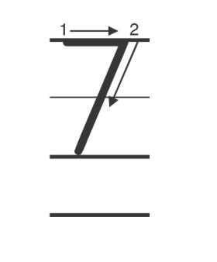
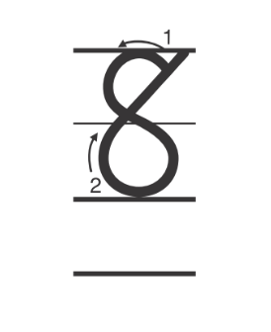
Handwriting
Notes:
Display the following numerals: 7, 8.
Model writing each numeral, calling students’ attention to starting on the top left of the 7 and at the top of the 8. Have them practice forming the numerals in the air.
Have students use Handwriting p. 270 from the Resource Download Center to practice writing 7 and 8. Click path: Realize -> Table of Contents -> Resource Download Center -> Handwriting Practice -> U5W2L1 Handwriting Practice

Slide 14
Page 83
Writing – Literary Nonfiction
Turn to page 83 in your Student Interactive.
Notes:
A question and answer book tells readers about a topic. Authors choose topics they know about. They think about the details that they will share with readers.
Tell students that authors write question and answer books about topics they know a lot about. Display a book from your stack and turn to the author biography. Read it aloud to students. Then return to the front cover of the book and ask what the book is about. Allow students to name the topic. Say: An author writes a book about something he or she knows about. Do you think the author knows a lot about this topic? Point out any connections between the author biography and the topic of the book.
Direct students to p. 83 of the Student Interactive. Read the top of the page aloud with them. Then say: Let’s start planning a book together. Our topic will be thunderstorms. We will write about thunderstorms because we all know about them. I will write the topic on the board: thunderstorms. Write the word on the board.
Next, say: Authors must think about the details they know about their topic before they write. Here are some details we know about thunderstorms. There is thunder. There is lightning. What else do we know about thunderstorms? Allow students to answer, and list their suggestions on the board.
Then say: Once we have listed what we know about our topic, we can begin forming questions and answers using the information. When you write your books, you might plan by listing what you know about your topic.

Slide 15
Independent Writing
Continue writing your book. Make sure to plan the details before you start writing.
Share your topic with the class and why you chose it.
Notes:
Students should continue working on their books. Tell them to choose a topic they know a lot about and plan the details before writing.
Writing Support
Modeled - Use stack texts to show a developed question and answer book.
Shared - As students write, share ideas and details.
Guided - Prompt students with questions about their topic to help them think of more details.
Ask two or three students to share their topic and details with the class. Ask students to share why they chose the topic and how they know about it.

Slide 16
Spelling
We have a flag outside our school.
Don’t slip on the ice!
Trap the bug and put it outside.
Stop and look before you cross the road.
It’s time to eat dinner.
I love to walk to school.
Notes:
(Note: Move the orange boxes to cover each bold spelling word before you read aloud the words and sentences.)
Read aloud the words and sentences. Have students spell each word with initial consonant blends and the two high-frequency words.
We have a flag outside our school.
Don’t slip on the ice!
Trap the bug and put it outside.
Stop and look before you cross the road.
It’s time to eat dinner.
I love to walk to school.
Reveal the spelling word and have students check their work.

Slide 17
Language and Conventions
My dad and I went to the store.
Edith and I played soccer.
Circle the capital letter at the beginning of the sentence. Circle the capital I.
Notes:
Review with students that sentences begin with a capital letter and the word I is always capitalized.
Display this sentence on the board: My dad and I went to the store. Ask a student to circle the capital letter at the beginning of the sentence as well as the capital I.
Have students work with a partner to circle the capital letters in the following sentence: Edith and I played soccer.

Slide 18
Lesson 2

Slide 19
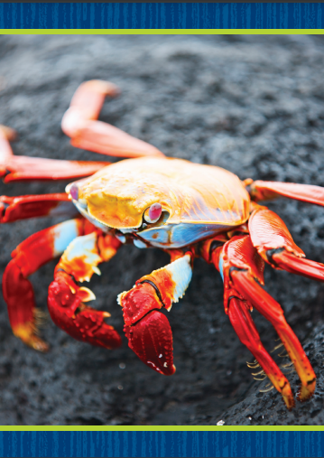
Phonics
camp
slid
Notes:
Hold up the crab Picture Card. This is a picture of a crab. I hear a blended sound at the beginning of crab. Say the blended sound with me: /kr/. Click path -> Table of Contents -> Unit 5 Week 2 Informational Text -> Lesson 2
Turn the card over and show students the spelling of the word. Point to the c and say /k/. Point to the r and say /r/. Then move your fingers quickly from c to r, and say /kr/. Do you hear the blended sound /kr/? What letters spell the blended sound /kr/? (the letters cr) Have students say other words that begin with the blended sound /kr/ spelled cr. Examples may include crop, crow, and crayon.
Write the words camp and slid on the board. Listen carefully as I blend the sounds in these words: /k/ /a/ /mp/, /sl/ /i/ /d/. Both words have a blended sound. One is at the beginning of the word, and one is at the end of the word. Listen: /k/ /a/ /mp/; /sl/ /i/ /d/. Which word has the blended sound at the end of it? Yes, camp. What letters spell the blended sound /mp/? Students should say the letters m and p. Continue the activity with the word slid.

Slide 20
Page 53
Apply
Turn to page 53 in your Student Interactive and complete the activity.
Notes:
Have students complete p. 53 in the Student Interactive.

Slide 21
High-Frequency Words
eat
soon
walk
Notes:
Tell students that high frequency words are words that they will hear and see over and over in texts.
Write and read the words eat, soon, and walk.
Have students
repeat the words after you.
spell each word, clapping as they say each letter.

Slide 22
Page 64
Preview Vocabulary
soil
bloom
ground
desert
Notes:
Introduce the words desert, soil, ground, and bloom from p. 64 in the Student Interactive.
Have students share what they already know about the words. Ask questions such as: What do you do know about deserts? What can be planted in soil? Have you ever dug into the ground? What are some things that bloom?
Based on the vocabulary, what do you think the text will be about?
Provide definitions of vocabulary words as needed. These words will help us understand the information given in A Desert in Bloom.

Slide 23
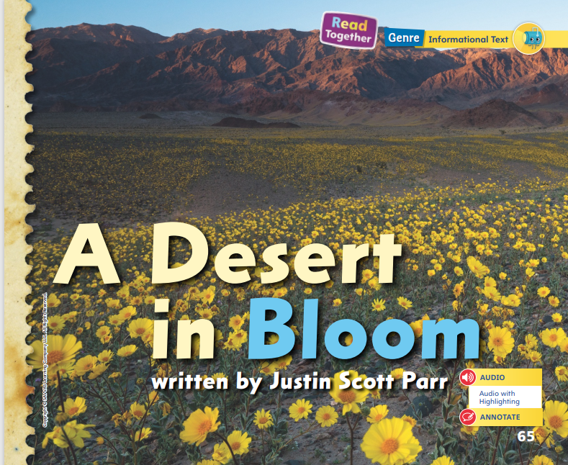
Page 65
First Read Strategies
Notes:
Discuss the First Read Strategies with students. Tell them that they should always set a purpose before reading a text. Look at the title and pictures. What do you hope to learn when reading this text?
First Read Strategies
READ Read or listen to the text. Work to understand what the text is about.
LOOK Look at the pictures to help you understand the text.
ASK Generate, or ask, questions about the text to deepen understanding.
TALK Guide students to talk to a partner about the text.
Students may read the text independently, in pairs, or as a whole class. Use the First Read notes to help students connect with the text and guide their understanding.

Slide 24
Page 66, 67
First Read – A Desert in Bloom
Notes:
Read Together.
THINK ALOUD Looking at details in the pictures can help me better understand what I am reading. Looking at the pictures on pages 66–67 helps me understand what the desert is like. I can see that the soil looks very dry and sandy. Then, when I look at the picture on page 68, I see that the soil looks dry and cracked. The words say that the ground is hot and dry, but the pictures help me understand what this looks like.

Slide 25
Page 68, 69
First Read – A Desert in Bloom
Notes:
Read Together.

Slide 26
Page 70, 71
First Read – A Desert in Bloom
Notes:
Read Together.
THINK ALOUD The text tells about how flowers in the desert grow, season by season. Talking about the text with a partner can help me understand what I’m reading. For example, on page 70, the text and pictures show that the ground is soaked in winter. I can ask my partner if she or he sees anything else in the text that tells about winter. Perhaps my partner will point out that the seeds start to grow in the winter because it is so wet.
Have students turn and talk to a partner about these pages.

Slide 27
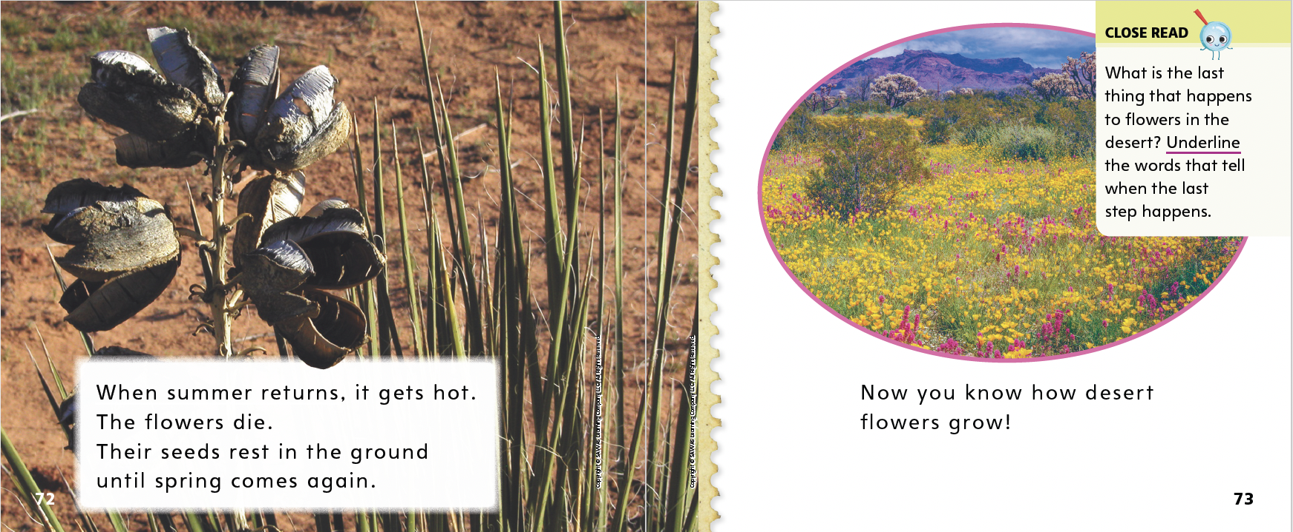
Page 72, 73
First Read – A Desert in Bloom
Notes:
Read Together.

Slide 28
Respond and Analyze
Retell: Talk with a partner about what you found most interesting from the text.
Illustrate: Draw the steps in the sequence discussed in the text.
Notes:
Use these suggestions to prompt students’ initial responses to reading A Desert in Bloom.
Retell Have students tell a partner which part of the text they found most interesting and use evidence from the text to explain why.
Illustrate Events Have students illustrate the steps in the sequence discussed in the text. Then have partners describe the steps by referring to each other’s illustrations.

Slide 29
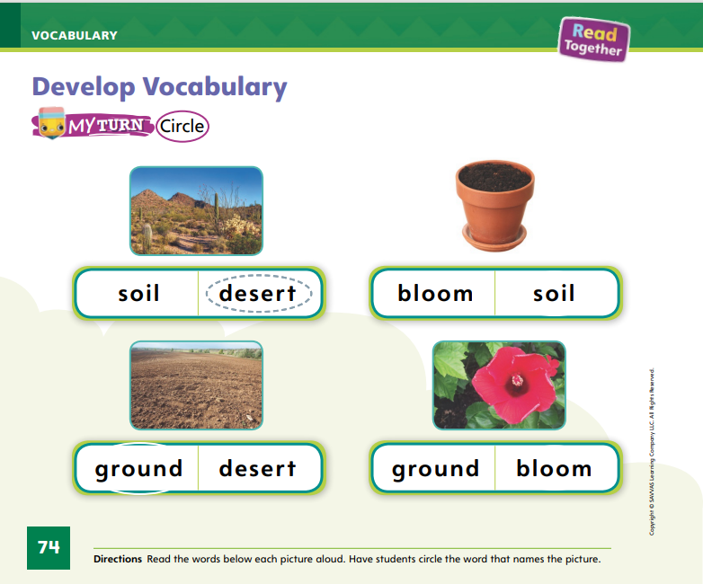
Page 74
Develop Vocabulary
Turn to page 74 in your Student Interactive and complete the activity.
Notes:
Tell students that they can often use images or illustrations to figure out the meaning of a word. The vocabulary words desert, soil, ground, and bloom can be used to talk about steps in a sequence discussed in A Desert in Bloom.
READ Read each word.
LOOK Look for pictures that help you visualize and understand the word.
THINK Think about how this word adds to the text.
Have students turn to p. 74 in the Student Interactive. Look at the first picture. Do you see soil or do you see the desert? Have students circle desert.
Have students practice developing vocabulary by completing p. 74 of the Student Interactive. Tell students that familiar words can have more than one meaning. Have students identify a new meaning for the verb to ground and use it in a sentence.

Slide 30
Page 75
Check for Understanding
Turn to page 75 in your Student Interactive and complete the activity.
Notes:
Have students complete the Check for Understanding on p. 75 of the Student Interactive.

Slide 31
Writing – Literary Nonfiction
who
what
where
when
why
how
Let’s think of questions we could ask about thunderstorms using the question words.
Notes:
Questions always begin with a question word. It is easy to remember question words by remembering the 5 Ws and H: who, what, where, when, why, and how.
Tell students that authors write question and answer books to give readers information about a topic. Say: Authors write questions by beginning their questions with who, what, where, when, why, or how.
Write the question words on the board. Read questions from a stack text aloud, emphasizing the question words. Continue reading questions from stack texts until students show understanding. Finally, decide on a topic your class knows a lot about, such as thunderstorms. One by one, go through the question words and ask students to think of questions they could ask about thunderstorms. Say: When you write your own book, make sure you begin each page with a question. Each question should begin with a question word.

Slide 32
Independent Writing
Continue writing your book. Make sure to use a variety of question words.
Share one question and explain why you chose that question word to start your question.
Notes:
After this lesson, students should transition into writing or drawing their own question and answer books. Display the question words and encourage students to choose a variety of question words for their books.
Writing Support
Modeled - Model using the 5 Ws and H to write questions about a topic.
Shared - Take turns writing questions using the 5 Ws and H.
Guided - Prompt students to think about one question for each question word.
Have a few students share one question with the class. Ask students to explain why they chose that question word to start their question.

Slide 33
Page 80
Spelling
Turn to page 80 in your Student Interactive and complete the activity.
slip
Notes:
Explain that CCVC words begin with two consonants. In words with initial consonant blends, both letters are heard and spelled.
Write slip on the board. Show students how slip fits the CCVC pattern by pointing out the beginning consonants, vowel, and ending consonant.
Have students complete the activity on p. 80 in the Student Interactive independently.

Slide 34
Language and Conventions
What did Jane play?
Jane played baseball.
What a great game!
What is the punctuation mark at the end of each sentence?
Notes:
Tell students that every sentence ends with a punctuation mark. Sentences that tell end with a period. Sentences that ask questions end with a question mark. Sentences said with excitement end with an exclamation point.
Display these sentences: What did Jane play? Jane played baseball. What a great game!
Ask: What is the punctuation mark at the end of each sentence?
Have students work in pairs to create oral sentences that tell, question, and exclaim. Have students share their sentences with the class, identifying the end punctuation mark of each one.

Slide 35
Lesson 3

Slide 36
Phonological Awareness
backpack
lunchroom
bathtub
Notes:
Say the word backpack. Listen carefully as I count the syllables: back (clap) pack (clap). How many times did I clap? Students should say two. How many syllables are in backpack? Students should say two. If I take away the first syllable, back, what word do I have left? Students should say pack. If I take away the second syllable, pack, what word do I have left? Students should say back.
Continue the routine with the words lunchroom and bathtub.

Slide 37
Page 54
Phonics
just
Turn to page 54 in your Student Interactive and complete the activity.
grab
Notes:
Write the word just on the board, and read it with students. This is the word just. I can read the word: /j/ /u/ /st/, just. I hear the sound /j/ at the beginning of just. Say the sound /j/ with me. What letter spells the sound /j/ in just? (the letter j) What blended sound do I hear at the end of just? Students should say /st/. What letters spell the blended sound /st/? (the letters s and t) Write grab on the board. This is the word grab. I can read the word: /gr/ /a/ /b/, grab. I hear the sound /b/ at the end of the word. What letter spells the sound /b/? (the letter b) I hear the blended sound /gr/ at the beginning of grab. What letters spell the blended sound /gr/? Students should say g and r
Today we are reviewing the spellings for the sounds /j/ and /b/. We are also reviewing the spellings of initial and final blends, such as /st/ and /gr/. Have volunteers identify the letters that spell each of the sounds and blends.
Direct students to p. 54 in the Student Interactive. Have partners read and act out the sentences on the page.

Slide 38
Page 55
High-Frequency Words
eat
Turn to page 55 in your Student Interactive.
soon
walk
Notes:
Tell students that today they are going to continue working with high-frequency words. You will see these words over and over in texts. Have students read the words at the top of p. 55 in the Student Interactive with you: eat, soon, walk.
Have students look at the words. Tell them to identify and point to each word as you say it. Say soon. Pause to let students find and point to the word. Say eat. Say walk. Repeat the activity until students are familiar with each word. Have students use the words in sentences.
Have students read the sentences on p. 55 with you. Ask them to identify the words eat, soon, and walk in the sentences and underline them. Then have students read the sentences with a partner.

Slide 39
Page 65
Find Text Structure
Notes:
Text structure is how an author organizes a text. When an author uses steps in a sequence, he or she often uses time words to tell when the steps happen.
Read the title. Can you tell whether the author is going to discuss steps in a sequence?
Look through the text. Does it contain pictures that may help you figure out if the author is going to explain a sequence?
Read the text and look for time words that tell when the steps happen.
Have students look back at A Desert in Bloom.
Ask students if the pictures give them any clues about a sequence the author is going to describe. I see in the pictures that the weather keeps changing. It was dry and sunny, then wet and cloudy, and then dry and sunny again. I think the author is going to tell about the sequence of the seasons in the desert.
Guide students to form oral sentences to describe what they see in the pictures. Then have students turn to the Close Read notes on pp. 69, 71, and 73 of the Student Interactive and underline the words that tell when the steps in the sequence occur.

Slide 40
Page 68, 69
Close Read – Find Text Structure
Turn to page 68 in your Student Interactive.
Notes:
Read the Close Read note on p. 69. Remind students to reread text they do not fully understand. Then have students underline words on pp. 68–69 that tell when the steps of a flower’s growth occur. DOK 1

Slide 41
Page 71
Close Read – Find Text Structure
Turn to page 71 in your Student Interactive.
Notes:
Read aloud the Close Read note on page 71. Guide students to identify the words that tell when these steps happen. DOK 1

Slide 42
Page 73
Close Read – Find Text Structure
Turn to page 73 in your Student Interactive.
Notes:
Read the Close Read note on p. 73 and prompt students to identify and underline the words that tell when the last thing happens to flowers in the desert. Point out that the text shows the sequence of steps in the order in which they happen. DOK 1

Slide 43
Page 76
Find Text Structure
Turn to page 76 in your Student Interactive and complete the activity.
Notes:
Have students use the strategies for finding the steps in a sequence in an informational text.
Have students complete p. 76 in the Student Interactive by writing when each step happens.

Slide 44
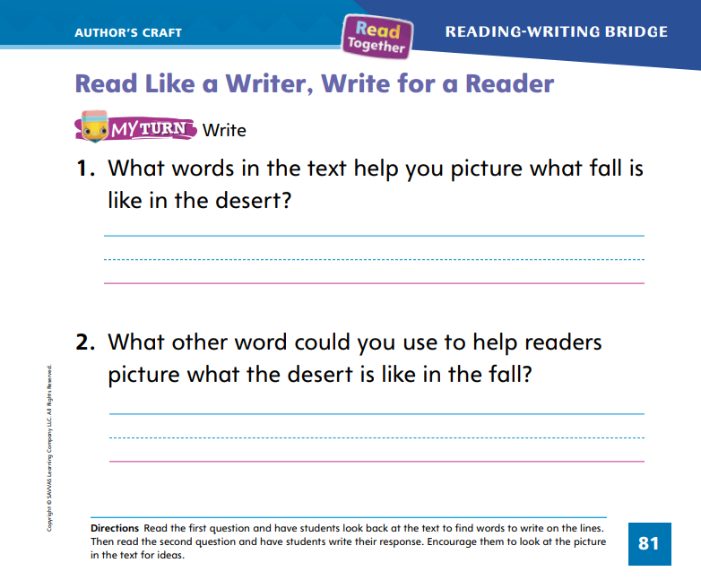
Page 81
Read Like a Writer, Write For a Reader
Turn to page 81 in your Student Interactive and complete the activity.
Notes:
Explain to students that authors choose specific words to help readers visualize, or picture, what is happening in the text. The author’s choice of words shows what the author wants to tell the reader.
Authors choose words carefully.
Vivid, interesting words can help readers picture what is happening and better understand what they are reading.
Model using the first question on p. 81 in the Student Interactive to show students how writers use vivid, interesting words. The question asks us which words the author uses to help the reader picture fall in the desert. To find the words, I need to look back in the text. On page 69, the author describes the desert in fall. Guide students in looking at and rereading p. 69, and discuss how the words cool and cloudy help students visualize fall in the desert. Have students complete Item 1. Then read Item 2 to students. Discuss possible answers with them.
Have students complete p. 81 in the Student Interactive.

Slide 45
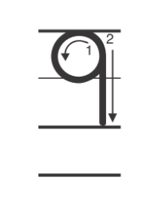
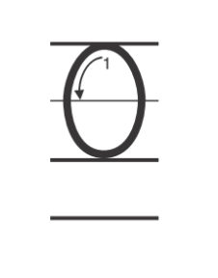
Handwriting
Notes:
Display the numerals 9 and 0.
Model writing each numeral, calling students’ attention to starting with the circle of the 9 and at the top of the 0. Have them practice forming the numerals in the air.
Have students use Handwriting p. 271 from the Resource Download Center to practice writing the numerals 9 and 0. Click path: Realize -> Table of Contents -> Resource Download Center -> Handwriting Practice -> U5W2L3 Handwriting Practice

Slide 46
Page 84
Writing – Literary Nonfiction
Turn to page 84 in your Student Interactive.
Notes:
Questions begin with a question word and end with a question mark. Writers choose which question word best matches each answer about the topic.
Have students recall what a question and answer book is. Explain that readers get information about a topic by first reading the question and then reading the answer.
Look through a stack text and read the questions aloud. Have students identify which of the 5 W and H words were used for each question. Ask them to identify the punctuation mark at the end of each question.
Next, say: Today I am going to teach you to write a question. Let’s pretend that I am writing a question and answer book about thunderstorms. I already made a list of what I know about my topic. One thing I know is that there is thunder during a thunderstorm. Thunder is a loud noise. How can I turn that information into a question? Let’s look at the list of question words and decide which one to use. I can use the question word what and write the question What do we hear during a thunderstorm? That is one question I will include in my book.
Write the question on the board. Point out the question word what and the question mark at the end of the sentence. Another thing I know about my topic is that during a thunderstorm, there is lightning. I will write a question for that information too. What do we see during a thunderstorm?
Write the question on the board. I wrote another question for my book. It begins with the word what, and it ends with a question mark. You can write questions like these for your book too.
Direct students to p. 84 of the Student Interactive and complete the activity together.

Slide 47
Independent Writing
Write questions that begin with a question word and end with a question mark.
Notes:
As students transition into independent writing, tell them to write questions that begin with a question word and end with a question mark.
Writing Support
Modeled - Write questions about topics from the stack books.
Shared - Have students look through stack texts to help them compose their questions.
Guided - Prompt students to think of question words as they write.
If students show understanding, tell them to continue writing their books.
Have a few students with whom you conferred share a question from their books. Ask them to think of another question that begins with a different question word.

Slide 48
Spelling
clap
drag
blot
sled
Notes:
Remind students that words with a CCVC spelling pattern often begin with a blend where both beginning consonants are heard and spelled.
Have students write the following words as you isolate each phoneme: clap—/k/ /l/ /a/ /p/; drag—/d/ /r/ /a/ /g/; blot—/b/ /l/ /o/ /t/; sled—/s/ /l/ /e/ /d/.
Have students complete Spell Words p. 27 from the Resource Download Center. Click path: Table of Contents -> Resource Download Center -> Spelling -> U5W2L3

Slide 49
Language and Conventions
Are we going to school?
You and I are at school.
School is fun!
Identify the punctuation mark at the end of each sentence.
Notes:
Remind students that there are three kinds of end punctuation. A telling sentence ends with a period. A question ends with a question mark. An exclamation ends with an exclamation point.
To reinforce end punctuation, write two examples of each type of sentence on the board. Read the sentences aloud, modeling appropriate intonation for questions and exclamations. Ask students to identify and name the punctuation mark at the end of each sentence.

Slide 50
Lesson 4

Slide 51
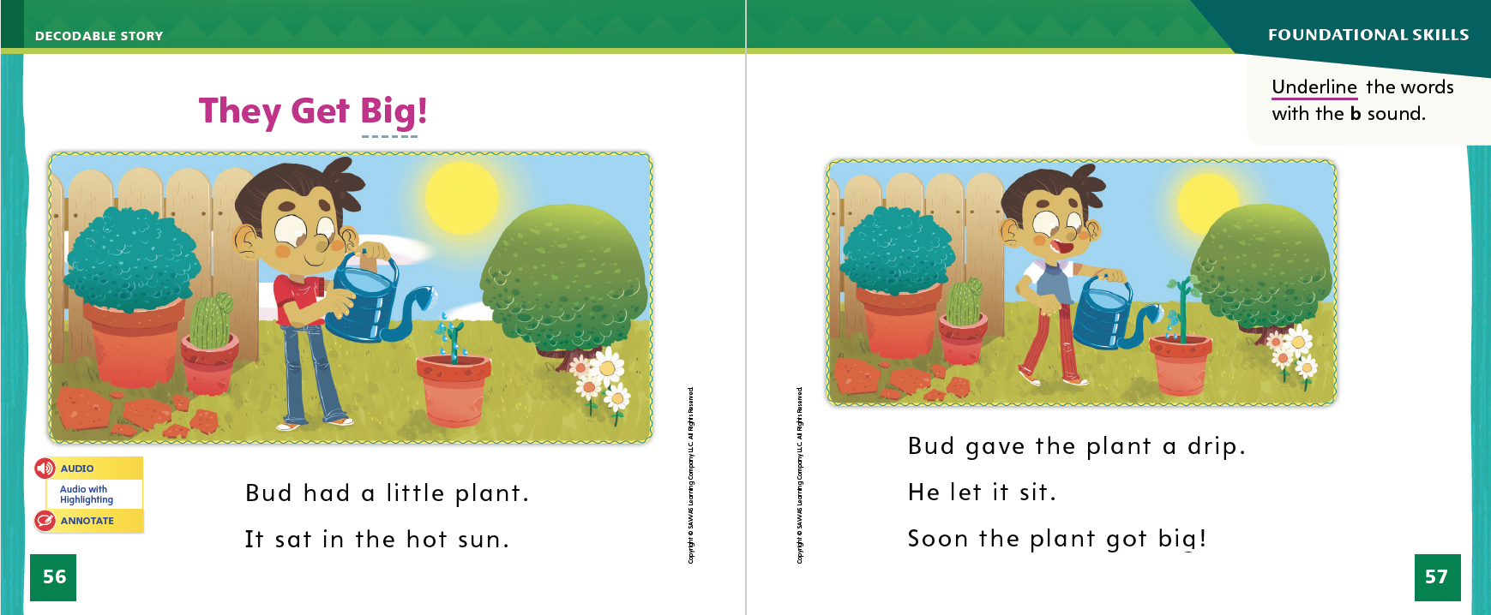
Page 56, 57
Decodable Story
eat
soon
walk
Turn to page 56 in your Student Interactive. We will Read “They Get Big!”
Notes:
Have students turn to p. 56 in the Student Interactive. We are going to read a story about things that grow. Point to the title of the story. The title is They Get Big! I hear a word with the sound /b/. Have students find and point to the word Big in the title. In this story, we will read words that have the sounds /b/ and /j/ and other sounds you have learned.
Remind students of this week’s high-frequency words: eat, soon, walk. Tell them they will practice reading these words in the story They Get Big! Display the words. Have students read them with you. When you see these words in the story They Get Big!, you will know how to identify and read them.
Have students whisper read the story as you listen in. Then have students reread the story page by page with a partner. Listen carefully as they use letter sound relationships to decode words. Partners should reread the story. This time the other student begins.
After students have read the story, call attention to the title on p. 56. I see the letter B in the last word. What sound does the letter B spell? Students should respond /b/. Have them underline the words with the sound /b/ spelled b on pp. 56–57. Have students read the words to you.

Slide 52
Page 58, 59
Decodable Story
Notes:
Have students turn to p. 58. I see a word in the first sentence with the letter J. What sound does the letter J spell? Students should respond /j/. Have students read the word Jen in the first sentence. What other word on page 58 has the sound /j/ spelled J? Students should identify the word Jen again.
Then have students highlight the words with /j/ spelled J on pp. 58–59.
On pages 58–59, I see the three high-frequency words we learned this week. Who can point to those words and read them aloud? Have a volunteer point to and read the words eat, Soon, and walk.

Slide 53
Page 65
Find Important Details
Notes:
Explain that details tell more about a topic. However, not all the details in a text are equally important. Some details provide more useful information than others. These are the most important details. Tell students:
Details tell me more about a topic.
Not all details in a text are important.
Important details give information that is key to understanding the text, while other details just provide nice-to-know information.
Model how to identify important details. Say: The text tells many details about deserts, but only a few of the details give information that I need to best understand what deserts are like.
Go back to the Close Read note on p. 67 of the Student Interactive. Highlight the most important detail about deserts.

Slide 54
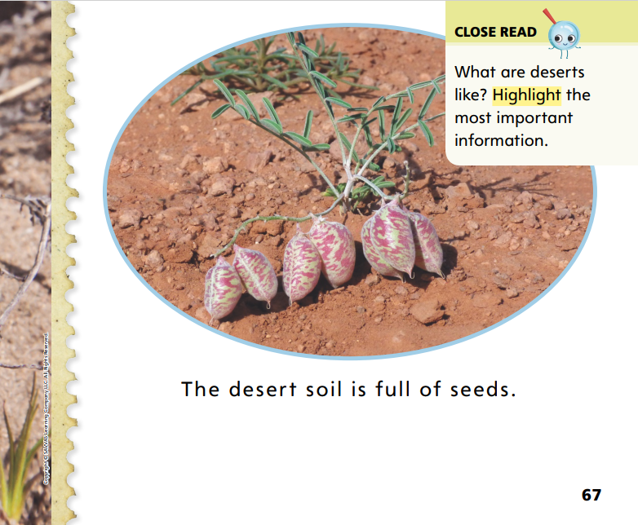
Page 67
Close Read – Find Important Details
Turn to page 67 in your Student Interactive.
Notes:
Read aloud the Close Read note on p. 67. Work with students to identify words that describe the desert. Guide them to understand that they can apply their knowledge of hot weather to better understand the text. DOK 2

Slide 55
Page 77
Find Important Details
Turn to page 77 in your Student Interactive and complete the activity.
Notes:
Have students use the strategies for finding important details.
Have students complete p. 77 in the Student Interactive.

Slide 56
Writing – Literary Nonfiction
Write answers to the questions in your book.
Answers should be a complete sentence.
It should begin with a capital letter and end with a period.
Notes:
Authors write question and answer books about topics they know a lot about. A question and answer book is composed of a series of questions and answers. Authors write questions and then they use what they know to compose the answers. When they do not know the answers, they use sources such as experts and research to find them.
Choose several books from the stack. Look through the books, reading questions and answers aloud to students. Highlight for students how questions are formatted (question words, question marks) and how the author answers each question. Say: An answer is written in a complete sentence. An answer does not end with a question mark. It usually ends with a period. Let’s look through these books and find the answers. Read a stack text. Pause on each page to have students identify the answers.
Continue reading questions and answers from stack texts until students show understanding. Finally, decide on a topic your class knows a lot about, such as thunderstorms. Pose questions to the class and have volunteers provide answers in complete sentences. Write the answers on the board. If students did not use a complete sentence, help them revise their answer so it is a complete sentence. Say: When you write your own book, make sure you write answers to your questions. Each answer should be a complete sentence. It should begin with a capital letter and end with a period.

Slide 57
Independent Writing
Continue writing your book by composing answers to your questions.
Share one of your answers with the class.
Notes:
After this lesson, students should work on composing answers to the questions in their question and answer books.
Writing Support
Modeled - Use stack texts to model how to compose an answer.
Shared - Tell students to make sure they are answering the question they asked. Help students write answers in complete sentences.
Guided - Prompt students to use details in their answers. If students do not know an answer to a question they wrote, have them revise the question so they know the answer or help them find the answer.
If students show understanding, have them continue writing their question and answer books.
Call on a few students to share one answer with the class. Have the class guess the question based on the answer.

Slide 58
Spelling
pan
van
got
rod
tap
hot
Notes:
Have students recall the previous spelling rules for spelling words with the CVC pattern with a short /a/ or /o/ sound.
Read the following words and have students spell them: pad, van, got, rod, tap, hot.
Have pairs work together to sort the words according to their short vowel sound.

Slide 59
Page 82
Language and Conventions
Turn to page 82 in your Student Interactive and complete the activity.
Notes:
Have students complete the activity on p. 82 in the Student Interactive.

Slide 60
Lesson 5

Slide 61
Page 60
Phonological Awareness
park
mile
lad
ban
plant
Notes:
Tell students that we can add sounds to words to make new words. Hold up the top Picture Card. Listen as I say the word top. Say it with me: top, /t/ /o/ /p/. Now we are going to add the sound /s/ to the beginning of top: /s/ -top. What is the new word? Students should say stop. Yes, by adding the sound /s/ to the beginning of top, we made the word stop. Now let’s try adding a sound to the end of a word to make a new word. Listen as I say the word ram. Let’s add the sound /p/ to the end: ram- /p/. What is the new word? Students should say ramp. Click path -> Table of Contents -> Unit 5 Week 2 Informational Text -> Lesson 5
Have students point to the picture of the word jump on p. 60 in the Student Interactive. Say: The girl jumped up. Let's make some new words by adding sounds to the word up. Then have them practice adding phonemes to the beginning of the word to make new words such as cup and pup. Then have students practice saying the following words and adding a phoneme to the beginning or end of each word to make a new word: park (spark), mile (smile), lad (glad), ban (band), plan (plant).

Slide 62
Page 60
Phonics
pr
mp
sl
Turn to page 60 in your Student Interactive.
Hope got a big ___ize.
Notes:
Tell students that they will read some sentences. The sentences you read include sounds and high-frequency words you have already learned.
Write the consonant blends pr, mp, and sl on the board, and review the sounds for the blends with students. Prompt them to come up with words that include each blend. Responses may include: prince, pretty, slime, slip, lamp, bump.
Have students turn to p. 60 in the Student Interactive. Let’s read the first sentence together: Hope got a big __ize. Which of the blends finishes the last word? Let’s try them: slize. Is slize a word? Students should say no. Let’s try another blend: prize. Is prize a word? Yes, it is, and it makes sense in the sentence: Hope got a big prize.

Slide 63
Page 60,61
Phonics
Turn to pages 60, 61 in your Student Interactive and complete the activity.
Notes:
Have students finish p. 60 in the Student Interactive by adding a blend to complete each word and reading the completed sentences.
Direct students to p. 61 in the Student Interactive. Have them read each sentence pair and then check the box beside the sentence that matches the picture.

Slide 64
High-Frequency Words
eat
soon
walk
Notes:
Remind students that high frequency words are words that appear over and over in texts. Remind them they are learning many of the words this year, and these words will help them become better readers.
Say the word eat and ask students what letters spell the word.
Have students
say the letters as you write them on the board.
say and spell the word, doing a silent cheer for each letter.
repeat with soon and walk.

Slide 65
Page 78
Reflect and Share
Turn to page 78 in your Student Interactive and complete the activity.
Notes:
Tell students that it is good to talk about or respond to a text they read. One way of responding is to tell your opinion about something the text discusses. Students should
make sure they understand what the texts are about.
think about ideas or information they could share with others.
speak loudly and clearly and use complete sentences.
take turns speaking.
Model sharing ideas and information about the topic using the Turn and Talk prompt on p. 78 of the Student Interactive. I know that the text told about deserts. Deserts are dry stretches of land that get very hot during the day. These sandy plains get very little rain. Rainforests are also hot areas, but the shade of the trees and rainfall can cool down the forests. Which place would you rather live in and why?
Have students complete p. 78 in the Student Interactive by telling their opinion about another place they have read about.

Slide 66
Page 78
Apply
What helps plants live in hot climates?
Notes:
Have students use evidence from the texts they have read this week to respond to the Weekly Question.
Tell them to write their responses on a separate sheet of paper.

Slide 67
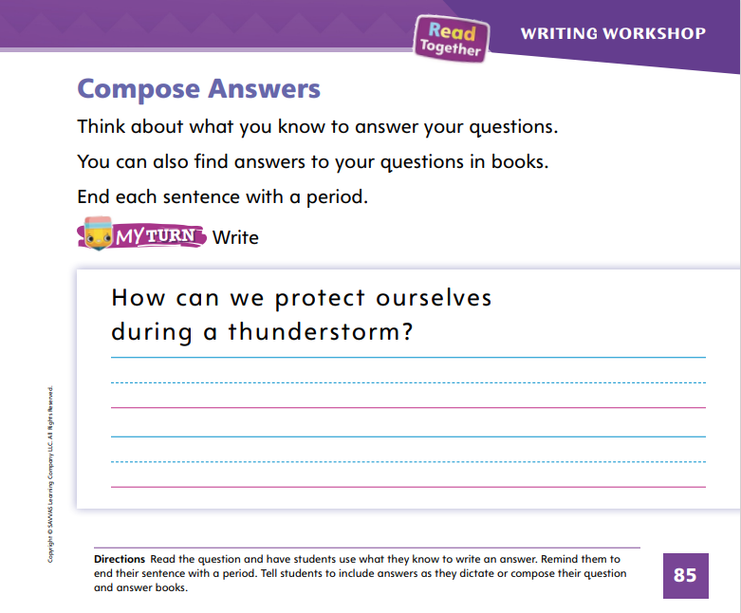
Page 85
Writing – Literary Nonfiction
Turn to page 85 in your Student Interactive.
Notes:
Authors write answers to questions by using what they know. Sometimes, authors need to learn more about a topic to write answers to questions. Answers are statements that end in a period and include facts. Answers to questions should
include information that relates back to the question.
help the reader better understand the topic.
begin with a capital letter and end with a period.
Tell students that authors might know a lot about a topic, and they should include this information in their answers. If they do not know the answers, they can research the answer in a book or by talking to an expert.
When writing answers, authors need to write in complete sentences, using a capital letter at the beginning and a period at the end. Tell students you are writing a question and answer book about thunderstorms. Tell them you have already written some questions. Write the following questions on the board: What do we hear during a thunderstorm? What do we see during a thunderstorm? Next, tell students that you will use what you know to write the answers. Think aloud as you write.
Say: The first question asks what we hear during a thunderstorm. I know that we hear thunder, so I will write: We hear thunder during a thunderstorm. The second question asks what we see during a thunderstorm. I will begin my answer with We see. What do we see during a thunderstorm? We see lightning. I will write: We see lightning during a thunderstorm.
Point out to students that each sentence starts with a capital letter and ends with a period. Both sentences answer the questions.
Direct students to complete the activity on p. 85 of the Student Interactive. Help students write complete sentences.
Have a few students share the answers they composed for their books.

Slide 68
Spelling
Tom set out a mouse trap.
Don't slip on the banana peel.
What time do you eat breakfast?
You can stop any time.
Our flag is red, white, and blue.
I walk to school with my brother.
Notes:
(Note: Move the orange boxes to cover each bold spelling word before you read aloud the words and sentences.)
Read aloud the words and sentences. Have students spell each word with initial consonant blends and the two high-frequency words.
Tom set out a mouse trap.
Don't slip on the banana peel.
What time do you eat breakfast?
You can stop any time.
Our flag is red, white, and blue.
I walk to school with my brother.
Reveal the spelling word and have students check their work.

Slide 69
Language and Conventions
Which sentence ends in a period?
Juan and I went swimming.
Where did Juan go swimming?
What a great swim!
Notes:
Guide students to answer the question.
Which sentence ends in a period?
Juan and I went swimming.
Where did Juan go swimming?
What a great swim!
Have students complete Language and Conventions, p. 285, from the Resource Download Center. Click path: Table of Contents -> Resource Download Center -> Language and Conventions -> U5 W2

Slide 70
Unit 5: Week 2
Grade K

